Slide 1
Delegates and Events
A delegate is a reference type that can be used to encapsulate a named or an anonymous method. Delegates are similar to function pointers in C++; however, delegates are type-safe and secure.
A delegate allow us to specify what the function we'll be calling looks like without having to specify which function to call.
Delegate declaration looks just like the declaration for a function, except that, we're declaring the signature of functions that this delegate can reference.
(Try to remember exactly even if you do not understand now.)

Slide 2
using System;
namespace Akadia.BasicDelegate
{
// Declaration
public delegate void SimpleDelegate();
class TestDelegate
{
public static void MyFunc()
{
Console.WriteLine("I was called by delegate ...");
}
public static void Main()
{
// Instantiation
SimpleDelegate simpleDelegate = new SimpleDelegate(MyFunc);
// Invocation
simpleDelegate();
}
}
}

Slide 3
class Program
{
public class MyClass
{
// Declare no return type.
public delegate void LogHandler(string message);
// Check if it is pointing to a function .
public void Process(LogHandler logHandler)
{
if (logHandler != null) logHandler("Process() begin");
if (logHandler != null) logHandler("Process() end");
}
}
// Test Application to use the defined Delegate
public class TestApplication
{
static void Logger(string s)
{
Console.WriteLine(s);
}
static void Main(string[] args)
{
MyClass myClass = new MyClass();
// Crate an instance of the delegate.
MyClass.LogHandler myLogger = new MyClass.LogHandler(Logger);
myClass.Process(myLogger);
}
}
}

Slide 4
public class FileLogger
{
FileStream fileStream;
StreamWriter streamWriter;
// Constructor
public FileLogger(string filename)
{
fileStream = new FileStream(filename, FileMode.Create);
streamWriter = new StreamWriter(fileStream);
}
// Member Function which is used in the Delegate
public void Logger(string s)
{
streamWriter.WriteLine(s);
}
public void Close()
{
streamWriter.Close();
fileStream.Close();
}
}
public class TestApplication
{
static void Main(string[] args)
{
FileLogger fl = new FileLogger("process.log");
MyClass myClass = new MyClass();
MyClass.LogHandler myLogger = new MyClass.LogHandler(fl.Logger);
myClass.Process(myLogger);
fl.Close();
}
}
No change to Process() function; the code to all the delegate is the same regardless of whether it refers to a static or member function.

Slide 5
Events
The Event model in C# has its roots in the event programming model that is popular in asynchronous programming.
The foundation behind it is the idea of "publisher and subscribers."
publishers will do some logic and publish an "event." They will then send out their event only to subscribers who have subscribed to receive the specific event.

Slide 6
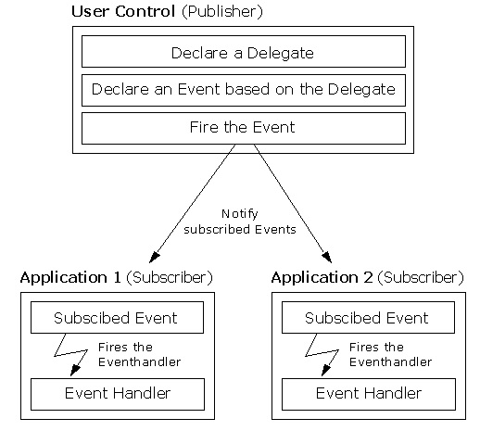
Any object can publish a set of events to which other applications can subscribe. When the publishing class raises an event, all the subscribed applications are notified.

Slide 7
Event Handlers
Event Handlers in the .NET Framework return void and take two parameters.
The first parameter is the source of the event; that is the publishing object.
The second parameter is an object derived from EventArgs.
Events are properties of the class publishing the event.
Events can be marked as public, private, protected, internal, protected internal or private protected. These access modifiers define how users of the class can access the event.

Slide 8
public class Clock
{
private int _hour; private int _minute; private int _second;
public delegate void SecondChangeHandler(object clock, TimeInfoEventArgs timeInformation);
// The event we publish
public event SecondChangeHandler SecondChange;
// The method which fires the Event
protected void OnSecondChange(object clock, TimeInfoEventArgs timeInformation)
{
// Check if there are any Subscribers
if (SecondChange != null)
{
// Call the Event
SecondChange(clock, timeInformation);
}
}
// Set the clock running, it will raise an event for each new second
public void Run()
{
for (; ; )
{ Thread.Sleep(1000);
// Get the current time
System.DateTime dt = System.DateTime.Now;
// If the second has changed notify the subscribers
if (dt.Second != _second)
{
// Create the TimeInfoEventArgs object to pass to the subscribers
TimeInfoEventArgs timeInformation = new TimeInfoEventArgs(dt.Hour, dt.Minute, dt.Second);
// If anyone has subscribed, notify them
OnSecondChange(this, timeInformation);
}
// update the state
_second = dt.Second; _minute = dt.Minute; _hour = dt.Hour;
} } }

Slide 9
The Clock class could simply print the time rather than raising an event.
The advantage of the publish / subscribe is that any number of classes can be notified when an event is raised.
The subscribing classes do not need to know how the Clock works,
Clock does not need to know what they are going to do in response to the event.
Similarly a button can publish an Onclick event, and any number of unrelated objects can subscribe to that event, receiving notification when the button is clicked.

Slide 10
The publisher and the subscribers are decoupled by the delegate.
This is highly desirable as it makes for more flexible and robust code.
The clock can change how it detects time without breaking any of the subscribing classes.
The subscribing classes can change how they respond to time changes without breaking the Clock.

Slide 11
Why use events for what I can do with Delegates?
The rationale of using events instead of delegates is the same as for using properties instead of fields - data encapsulation. It's bad practice to expose fields (whatever they are - primitive fields or delegates) directly.

